Slide 1


Object Oriented Analysis and Design with Java
UE20CS352
Prof Nivedita Kasturi
Department of Computer Science and Engineering

Slide 2


UE20CS352: Object Oriented Analysis and Design with Java
OO Design Patterns
Prof Nivedita Kasturi
Department of Computer Science and Engineering

Slide 3
UE20CS352: Object Oriented Analysis and Design with Java
Unit-4
Creational Patterns – Prototype

Slide 4
Agenda
Prototype-definition
Motivation
Intent
Implementation
Applicability
Structure-Consequence
Issues

Slide 5
Prototype : Class, Object Structural
Motivation
The Prototype Pattern specify the kind of objects to create using a prototypical instance, and create new objects by copying this prototype.
Use the Prototype Pattern when a client needs to create a set of objects that are alike or differ from each other only in terms of their state and creating an instance of a such object (e.g., using the “new” keyword) is either expensive or complicated.
The Prototype Pattern allows you to make new instances by copying existing instances.
– In Java this typically means using the clone() method or de-serialization when you need deep copies
Key aspect of this pattern:
– Client code can make new instances without knowing which specific class is being instantiated

Slide 6
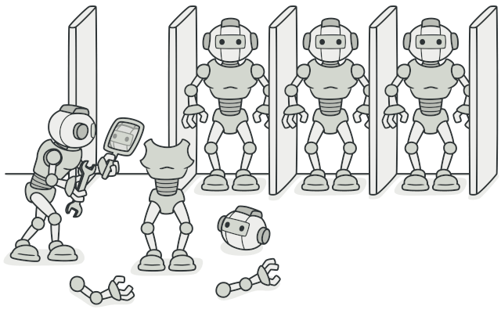
Prototype : Class, Object Structural
Intent
Prototype is a creational design pattern that lets you copy existing objects without making your code dependent on their classes.
Usage examples: The Prototype pattern is available in Java out of the box with a Cloneable interface.
Any class can implement this interface to become cloneable.
java.lang.Object#clone() (class should implement the java.lang.Cloneable interface)
Identification: The prototype can be easily recognized by a clone or copy methods, etc.
Notes:
Prototype is a creational design pattern that allows cloning objects, even complex ones, without coupling to their specific classes.
All prototype classes should have a common interface that makes it possible to copy objects even if their concrete classes are unknown. Prototype objects can produce full copies since objects of the same class can access each other’s private fields.

Slide 7
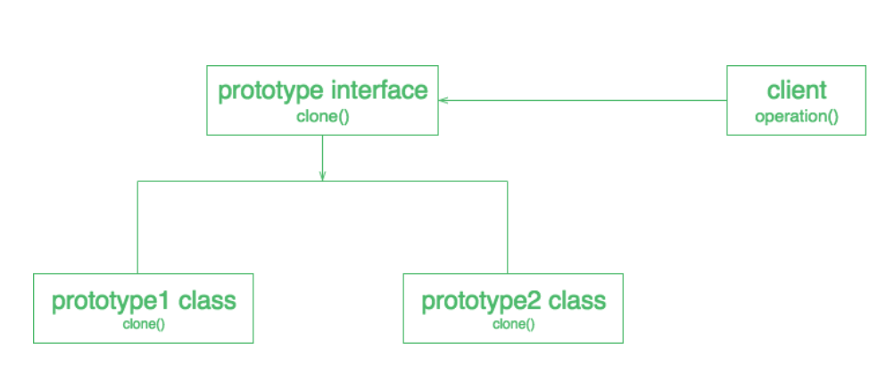
Prototype : Implementation
UML class diagram for the Prototype Pattern

Slide 8
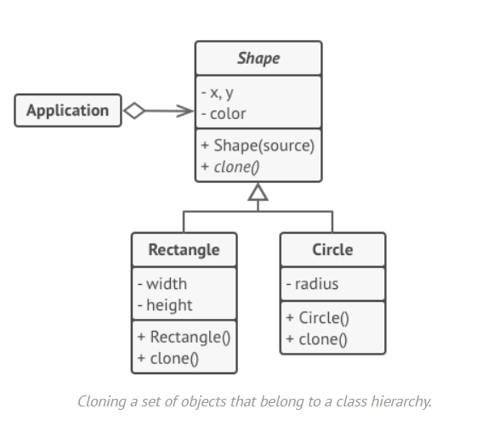
Prototype : Implementation example-1
Problem Statement:
In this example, the Prototype pattern lets you produce exact copies of geometric objects, without coupling the code to their classes.
All shape classes follow the same interface, which provides a cloning method. A subclass may call the parent’s cloning method before copying its own field values to the resulting object.

Slide 9
Solution
Let’s take a look at how the Prototype can be implemented without the standard Cloneable interface.
Link to Java Implementation
Note: Its example for prototype with different shape objects
Its eclipse file java files will be in src/prototypeDesignPatternDemo
Prototype registry
You could implement a centralized prototype registry (or factory), which would contain a set of pre-defined prototype objects. This way you could retrieve new objects from the factory by passing its name or other parameters. The factory would search for an appropriate prototype, clone it and return you a copy.
Note: Use main method which is implemented using BundledShapeCache
BundledShapeCache cache = new BundledShapeCache();

Slide 10
Prototype : Scenario example-2
The Prototype pattern specifies the kind of objects to create using a prototypical instance.
Prototypes of new products are often built prior to full production, but in this example, the prototype is passive and does not participate in copying itself.
The mitotic division of a cell - resulting in two identical cells - is an example of a prototype that plays an active role in copying itself and thus, demonstrates the Prototype pattern.
When a cell splits, two cells of identical genotype result. In other words, the cell clones itself.

Slide 11
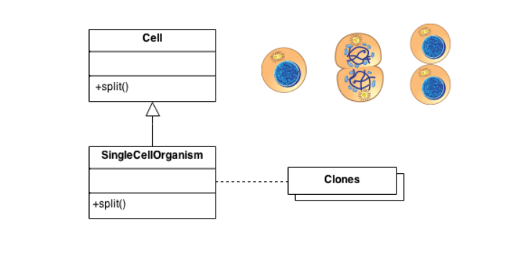
Prototype : Scenario example-2
Check list
Add a clone() method to the existing "product" hierarchy.
Design a "registry" that maintains a cache of prototypical objects. The registry could be encapsulated in a new Factory class, or in the base class of the "product" hierarchy.
Design a factory method that: may (or may not) accept arguments, finds the correct prototype object, calls clone() on that object, and returns the result.
The client replaces all references to the new operator with calls to the factory method.

Slide 12
Applicability
Use the Prototype pattern when
Use the Prototype pattern when a system should be independent of how its products are created, composed, and represented; and
when the classes to instantiate are specified at run-time, for example, by dynamic loading; or
to avoid building a class hierarchy of factories that parallels the class hierarchy of products; or
when instances of a class can have one of only a few different combinations of state. It may be more convenient to install a corresponding number of prototypes and clone them rather than instantiating the class manually, each time with the appropriate state.
Notes:
Use when a system should be independent of how its products are created, composed and represented and > When classes to instantiate are specified at run time dynamic loading > To avoid building a class hierarchy of factories that parallels the class hierarchy of products > When instances of a class can have one of a few different combinations of state – More convenient to install corresponding number of prototypes and clone them – undo command case study

Slide 13
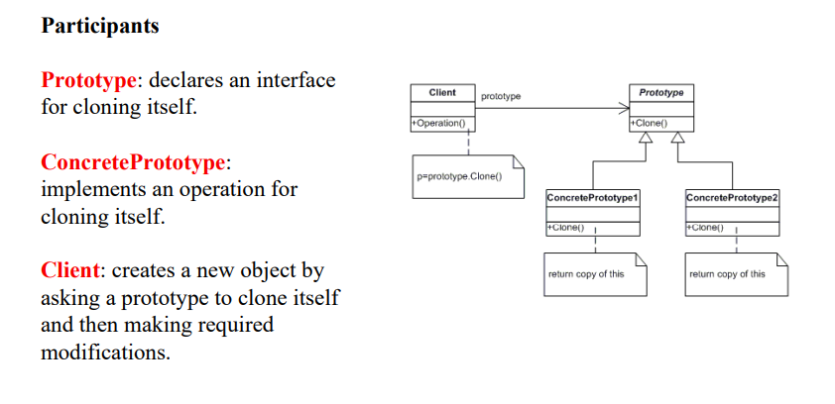
Structure

Slide 14
Collaboration
A client asks a prototype to clone itself.
Consequence
Additional benefits of the Prototype pattern are listed below.
Adding and removing products at run-time.
Specifying new objects by varying values
Specifying new objects by varying structure.
Reduced subclassing.
Configuring an application with classes dynamically.
Notes:
Prototype has many of the same consequences that Abstract Factory (99) and Builder (110) have: It hides the concrete product classes from the client, thereby reducing the number of names clients know about. Moreover, these patterns let a client work with application-specific classes without modification. Additional benefits of the Prototype pattern are listed below.
The main liability of the Prototype pattern is that each subclass of Prototype must implement the Clone operation, which may be difficult. For example, adding Clone is difficult when the classes under consideration already exist. Implementing Clone can be difficult when their internals include objects that don't support copying or have circular references.

Slide 15
Issues to consider when using the Prototype pattern
Consider the following issues when implementing prototypes:
Using a prototype manager. : When the number of prototypes in a system isn't fixed (that is, they can be created and destroyed dynamically), keep a registry of available prototypes. Clients won't manage prototypes themselves but will store and retrieve them from the registry. A client will ask the registry for a prototype before cloning it. We call this registry a prototype manager.
Implementing the Clone operation. The hardest part of the Prototype pattern is implementing the Clone operation correctly. It's particularly tricky when object structures contain circular references.
Initializing clones. While some clients are perfectly happy with the clone as is, others will want to initialize some or all of its internal state to values of their choosing. You generally can't pass these values in the Clone operation, because their number will vary between classes of prototypes. Some prototypes might need multiple initialization parameters; others won't need any. Passing parameters in the Clone operation precludes a uniform cloning interface.

Slide 16
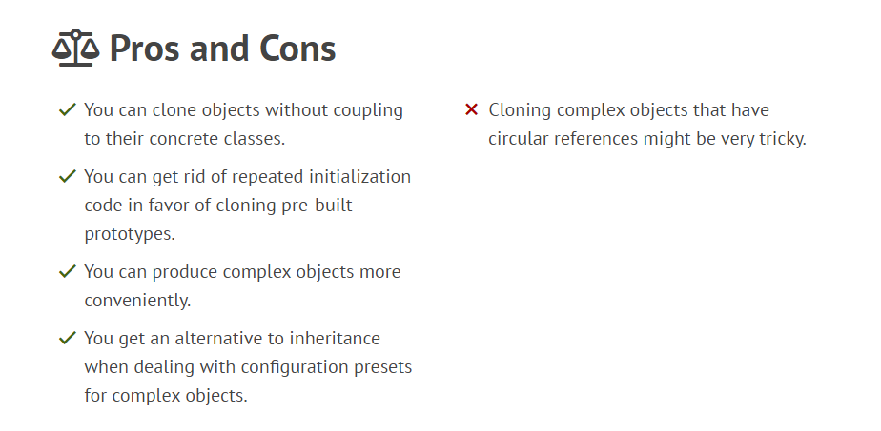
Pros and Cons

Slide 17
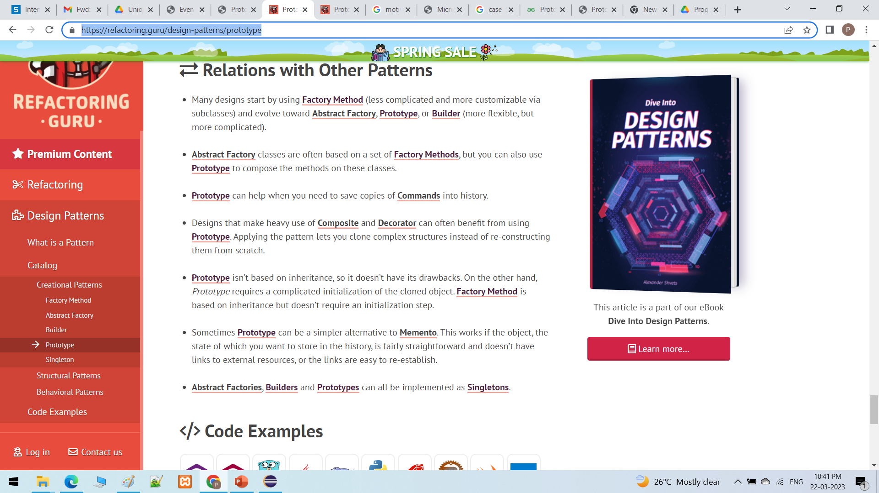
Relationship with Other patterns

Slide 18
References
Text Reference
Design Patterns: Elements of Reusable Object-Oriented Software, GOF
Web Reference
https://sourcemaking.com/design_patterns/prototype
https://www.geeksforgeeks.org/prototype-design-pattern/

Slide 19
THANK YOU
Prof Nivedita Kasturi
Department of Computer Science and Engineering
niveditak@pes.edu

